Slide 1

Javascript
12. marts 2018

Slide 2

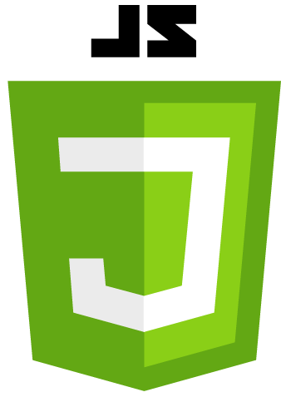




What is a website?
Notes:
Explain all parts

Slide 3
What is a website?

Slide 4
HTML – HyperText Markup Language
Defines the structure of a webpage
CSS – Cascading Style Sheet
Defines the visual presentation of HTML elements
JS – Javascript
Handles user interaction and dynamic content

Slide 5
Information
Today we are gonna be using two files to supplement our exercises.
Open the files lesson4.html and lesson4.js in your preferred Code Editor
Unless stated otherwise, perform the exercises in the these files.

Slide 6

General information and History

Slide 7
Javascript – General
Introduced in 1995
Dynamically typed, imperative, functional, prototyped and object oriented
Today → ECMAScript 2015 / ES6
Primarily client-side, event driven, implementations vary… a lot…

Slide 8
Javascript and other languages
Javascript is to Java, what Carpet is to Car
I.e. not related.
Javascript is very different from the programming languages normally taught at universities.

Slide 9
History
Created by Brendan Eich in 1995 for Netscape Navigator 2
Initially called Mocha and later LiveScript
On release of 1.1, name changed to JavaScript
In 1997 Javascript 1.1 was submitted to ECMA as a proposal. TC39 was assigned to standardize the syntas and semantics of the language.
TC39 released ECMA-262 known as ECMAScript
ECMAScript is the basis for all Javascript implementations

Slide 10

Programming with JavaScript

Slide 11
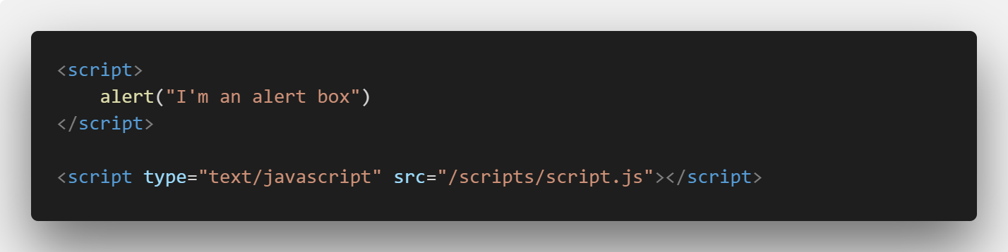
Running JavaScript
There are two ways:

Slide 12
Variables – 4 types
Local: using the var or let keyword
Global: declared without var or attached directly to window object.
Constants: const keyword
We assign values to variables using = (assignment operator)

Slide 13
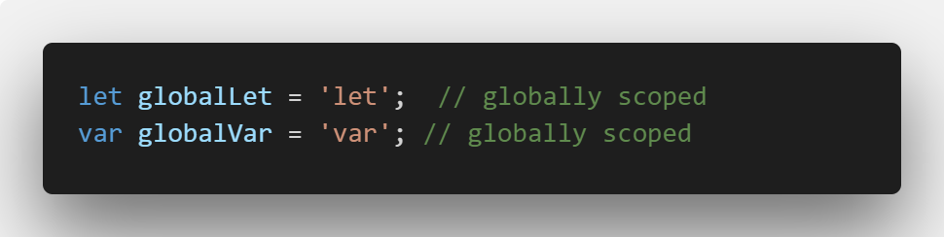
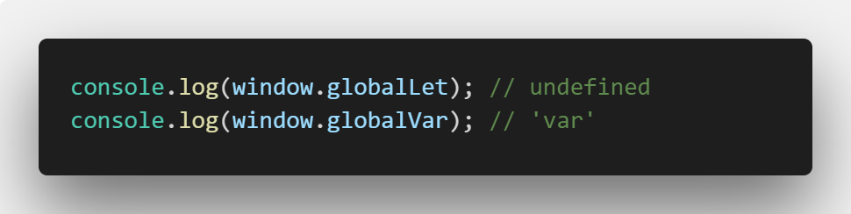
var vs. let - Global
Very similar outside function block
However let variables will not be added to window object, var will.

Slide 14
Exercise - Create some variables - Print the variables to the console 10 minutes

Slide 15
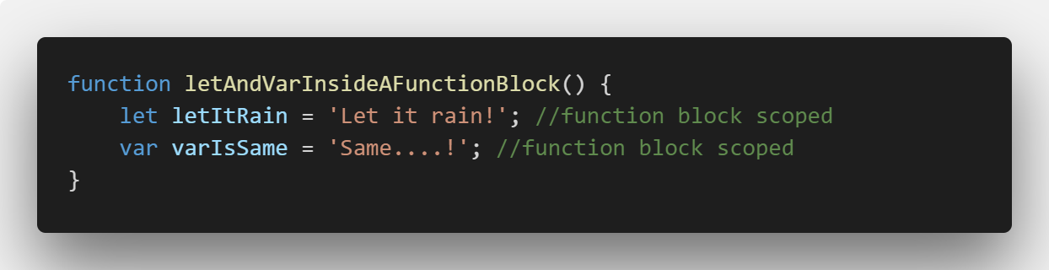
var vs. let - Function
They are identical when used like this in a function block

Slide 16
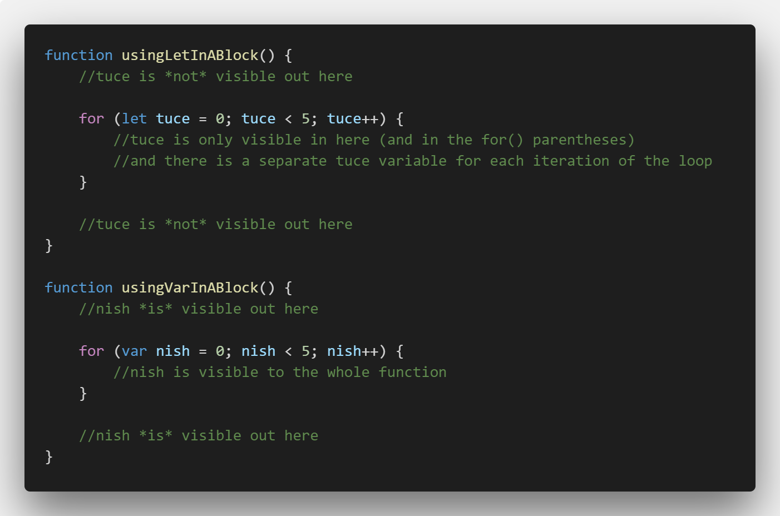
var vs. let - Block
Here lies the difference.
let is only visible in the for() loop
var is visible to the whole function

Slide 17
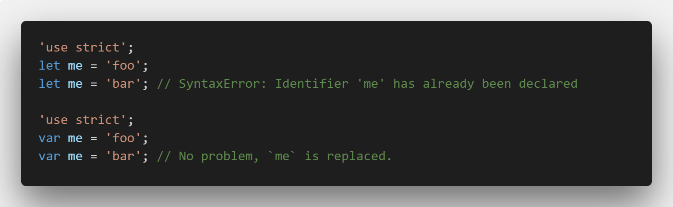
var vs. let - Redeclaration
Assuming strict mode, var will let you re-declare the same variable in the same scope. On the other hand, let will not:

Slide 18
var vs. let – My recommendation
Use let, I cannot see any reason to use var anymore.

Slide 19
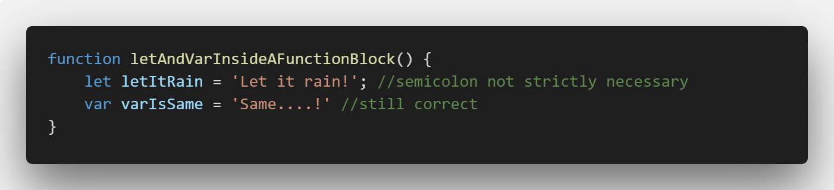
Statements
Can be separated with new-line or semicolon (;)

Slide 20
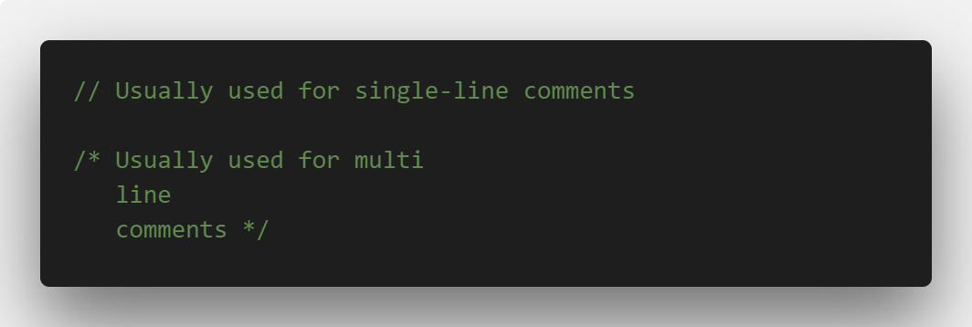
Comments
Two ways:
//
/* */

Slide 21
Data types
JavaScript is a loosely typed language
Java and C# are strictly typed

Slide 22
Data types - Numbers
Numbers: 3, -3, 3.33, -3.33 – These are numbers. We don’t differentiate integers and floats.
Addition, subtraction, division, multiplication and modulo division.
Results are always promoted to floats, when possible.
Assignment operators: +=, -=, /=, *= and %=
Special operators: increment (++) and decrement (- -)

Slide 23
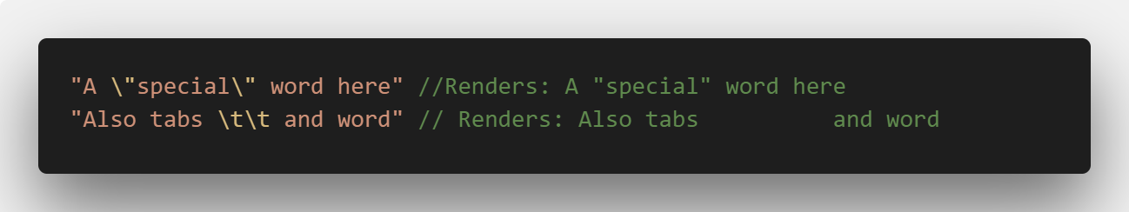
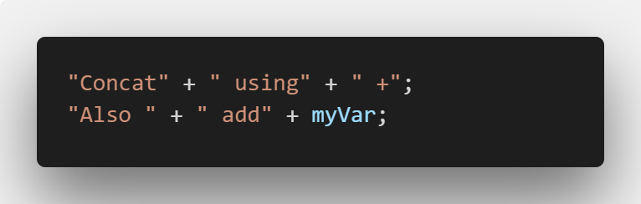
Data types - Strings
A series /sequence of characters from zero to infinity
Can contain any character
Can be created using single or double quotes
Use backslash ( \ ) to escape special characters:
Concatenation:

Slide 24
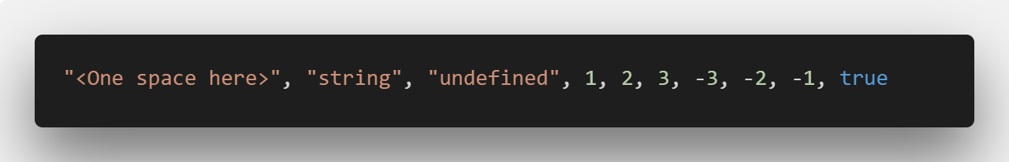
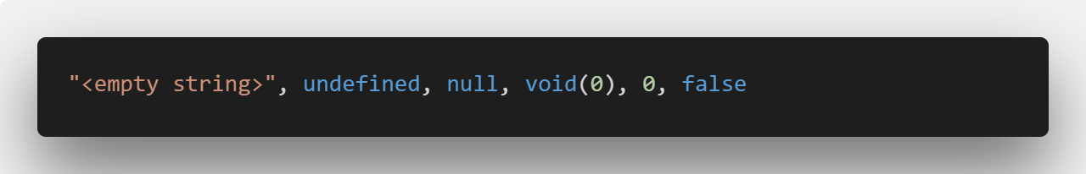
Data types - Booleans
True or false
Cases for True:
Cases for False:

Slide 25
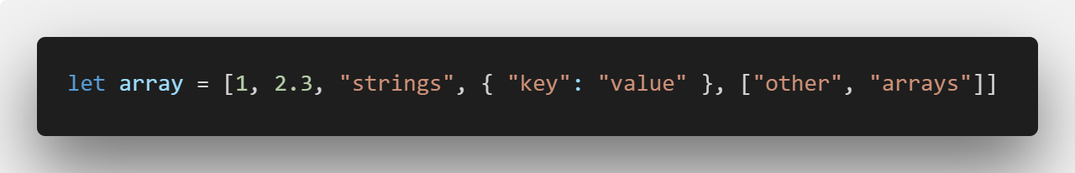
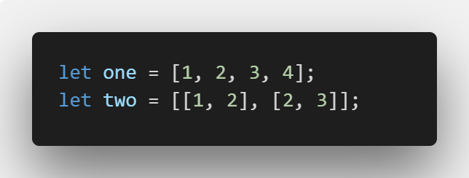
Data types - Arrays
Holds a collection of items
Can store any data types together in a single array
2 types of arrays: 1 dimensional and multi dimensional
Accessiong values in an array is done via index. Ranges from 0 to mins -1 (arrays length)

Slide 26
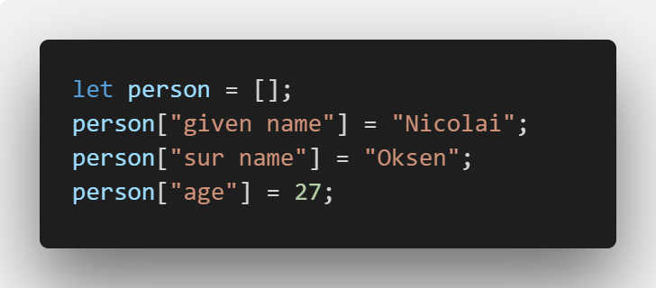
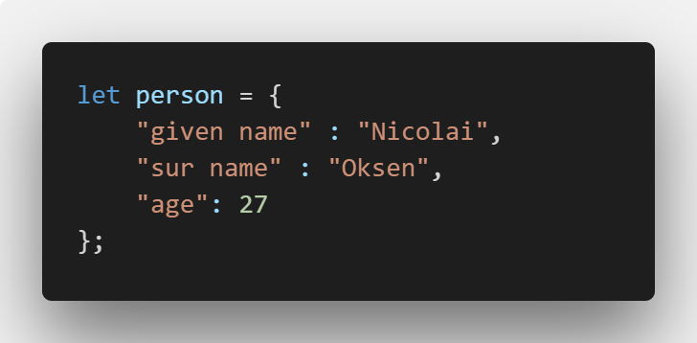
Data types - Objects
Are also known as Associative Arrays
Regarded as Key-Value pairs
Example:
As normal object:

Slide 27
Exercise - Create variables of type - Array, Object, Number, Boolean and String - Print them to the console - Try overwriting variables with another type 15 minutes

Slide 28
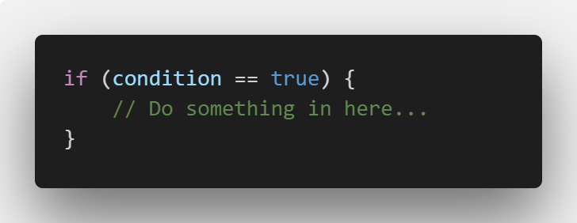
Controlling the flow
Conditions is basically making decisions
If statements: Expects a Boolean expression
Example:

Slide 29
Controlling the flow (cont.)
Comparison operators:
Less than (<)
Greater than (>)
Less than equal to (<=)
Greater than equal to (>=)
Equal to (==)
Not equal to (!=)
Not (!)
Multiple conditions operators:
And (&&)
Or (||)

Slide 30
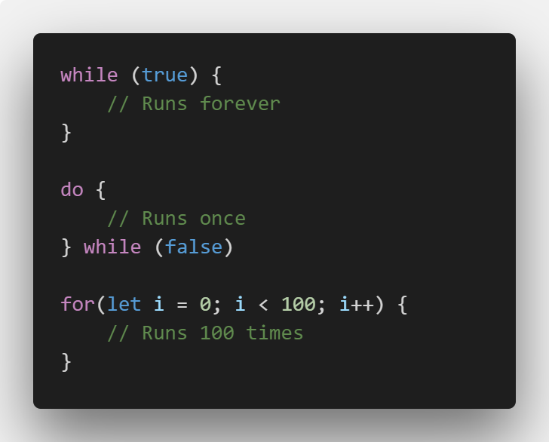
Loops
Loops helps to minimize the repetition
While: Simplest loop. While something is true, it runs
Do-While: Runs at least once. Condition is evaluated after running body
For: Succinct all the above
All loops should contain three things:
Incrementer
conditional expression
logic to increase incrementer.

Slide 31
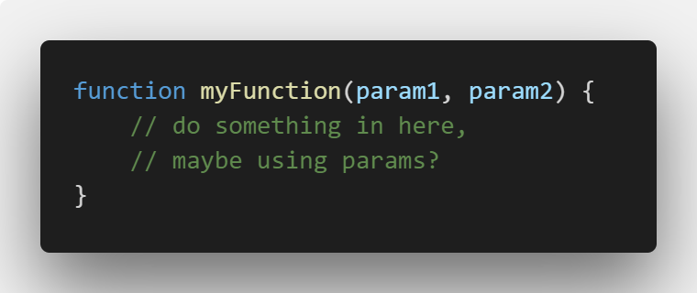
Writing code for later - Functions
If we want to re-run some code again and again from different places.
Predefined functions:
alert()
prompt()
confirm()
Functions can return values.

Slide 32
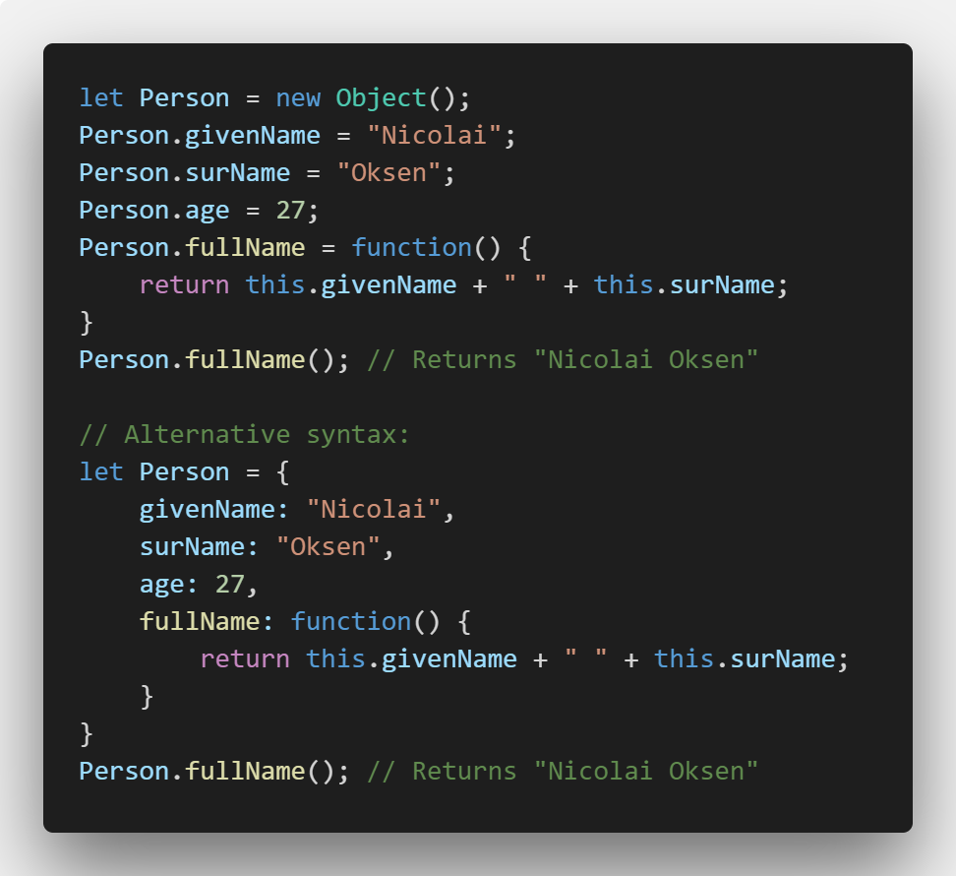
Objects – again!
Objects exists as a way of organizing variables and functions into logical groups.
Built in objects:
String
Date
Math
Boolean
Number
RegExp
Object
Array

Slide 33
Exercise - Make a function that adds two numbers - Make it return the result - Catch the result in a variable - Call the function multiple times - Print the result to the console 15 minutes

Slide 34

Document Object Model - DOM

Slide 35
What is the DOM?
The Document Object Model (DOM) is a programming interface for HTML and XML documents
It represents the page, so that programs can change the document structure, style and content
The DOM represents the document as nodes and objects. This makes it easier for programming languages to interact with a page.

Slide 36
DOM Structure
HTML
HEAD
BODY
DIV
TITLE
Title text
META
Meta information
SECTION
P
A
Etc.
Converts the HTML document to a tree structure.

Slide 37
DOM Structure (cont.)
Even if the document is blank a grand node always exists!
It is called document
Document
BODY
HEAD
HTML

Slide 38
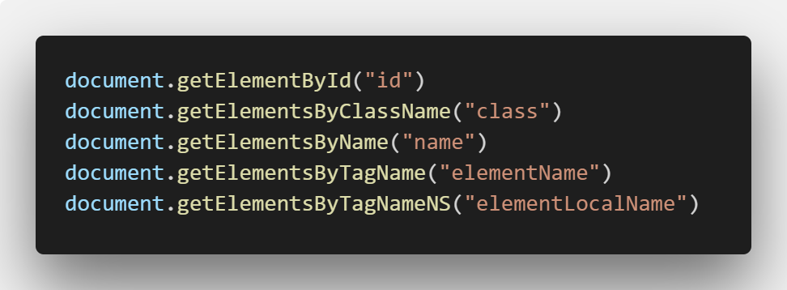
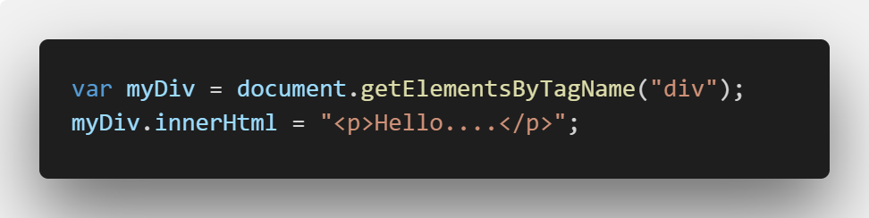
DOM Manipulation
Accessing elements:
Alter properties (depends on the node type):

Slide 39
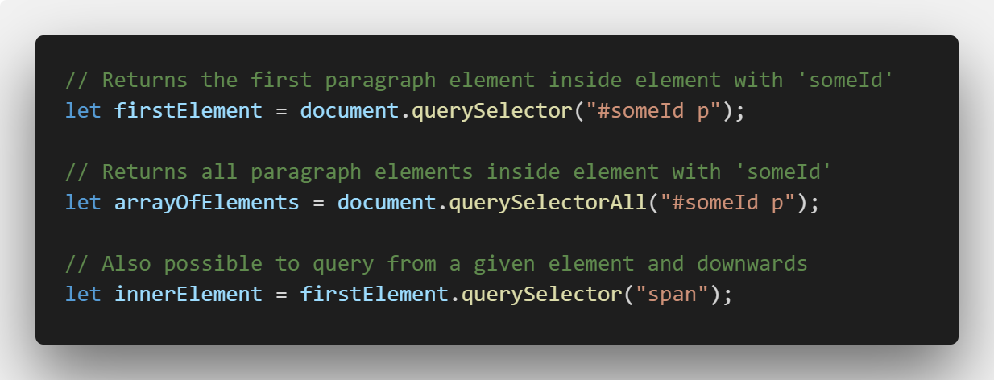
DOM Manipulation (cont.)
Querying elements:

Slide 40
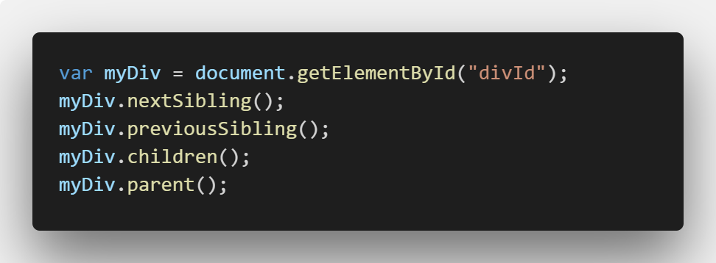
DOM Manipulation (cont.)
Traversal:

Slide 41
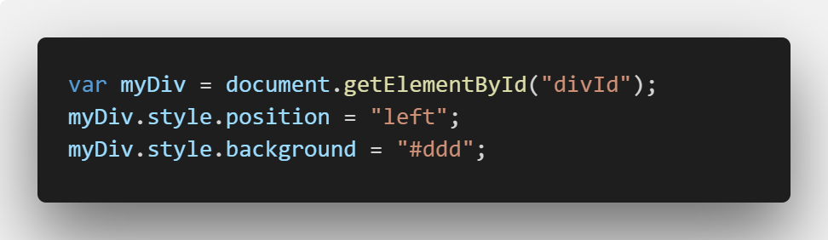
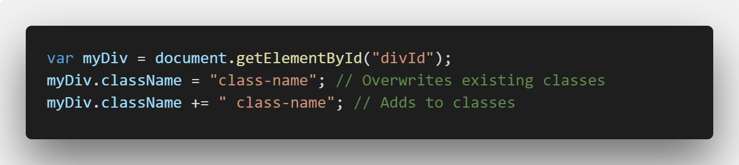
DOM Manipulation (cont.)
Manipulation style:
Manipulating classes:

Slide 42
Exercise - Query different elements in lesson4.html - Adjust styling to your liking - Try multiple different accessor methods 20 minutes

Slide 43
Browser access
Browser Object Model (BOM)
Targets browser instead of HTML Document.
Offers up objects to allow access to browser information and manipulate information
Objects:
window
location
navigator
screen
history

Slide 44
Events
JavaScript enables us to listen for DOM specific events and trigger our own custom code on those events.
Events examples: clicking something, hovering mouse, pressing a keyboard key and submitting a form.

Slide 45
Events – All JavaScript events
onafterprint onbeforeprint onbeforeunload onerror onhashchange onload onmessage onoffline ononline onpagehide onpageshow Onpopstate onresize | onstorage onunload onblur onchange oncontextmenu onfocus oninput oninvalid onreset onsearch onselect onsubmit onkeydown | onkeypress onkeyup onclick ondblclick ondrag ondragend ondragenter ondragleave ondragover ondragstart ondrop onmousedown onmousemove | onmouseout onmouseover onmouseup onmousewheel onscroll onwheel oncopy oncut onpaste onabort oncanplay oncanplaythrough oncuechange | ondurationchange onemptied onended onerror onloadeddata onloadedmetadata onloadstart onpause onplay onplaying onprogress onratechange onseeked | onseeking onstalled onsuspend ontimeupdate onvolumechange onwaiting onerror onshow ontoggle

Slide 46
Events – Event handlers
The simplest way to hook into these events is through an event handler (which is a function)
Element
Event Handler
Execute code

Slide 47
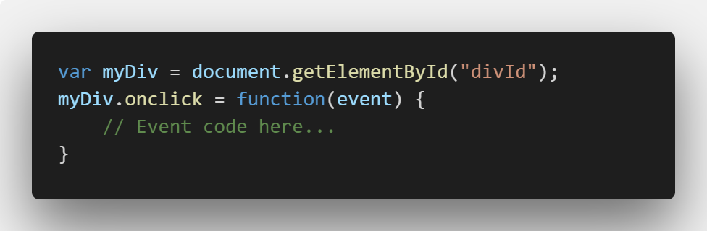
Events – Event handlers (cont.)
Attaching to an event:

Slide 48
Events – default actions
Default actions, when talking about events, is what the browser normally does in response to events.
How to prevent?
Return true or false

Slide 49
Events – this object
Whenever entering an event handler, the this object is populated as the clicked HTML element, represented as an object.
We cannot change the value of this

Slide 50
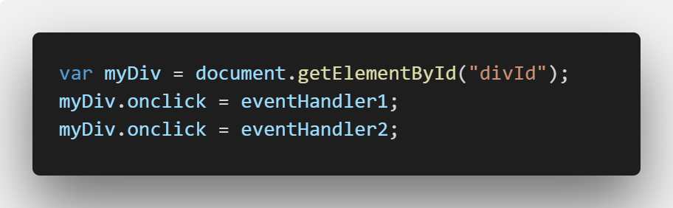
Events – Event listeners
Firstly – what is wrong with event handlers?
Well, you can’t assign multiple handlers to a single event! Remember it was assigned using =
I.e. in the image only eventHandler2 will be called
Using event listeners, we can assign
As many as we want.
All assigned event listeners will be called.

Slide 51
Events – Event listeners (cont.)
Element
Event listener 1
Event listener 2
Event listener n
On click
…
It works like a hub.

Slide 52
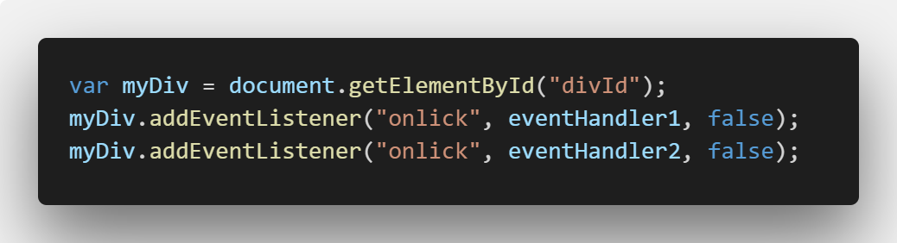
Events – Attaching event listeners

Slide 53
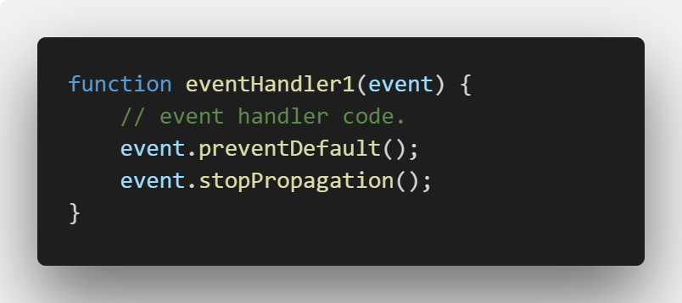
Events – The event parameter
An event parameter is passed to all event listener functions.
The event parameter has some important methods. Two are seen above.
Exercise: What does the above do? 10 minutes!

Slide 54
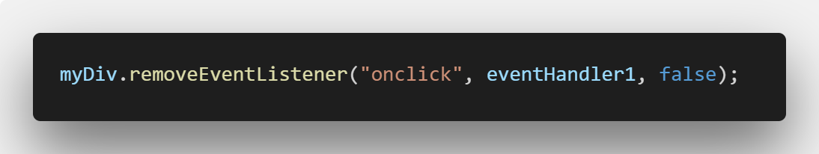
Events – Detaching events

Slide 55
Events - Propagation
What is event propagation?
Well you already researched the method!
Propagation: transmission or dissemination.
Event propagation happens in three phases
Capture: Document to element
Target: Element which triggered event
Bubbling: Element to document

Slide 56
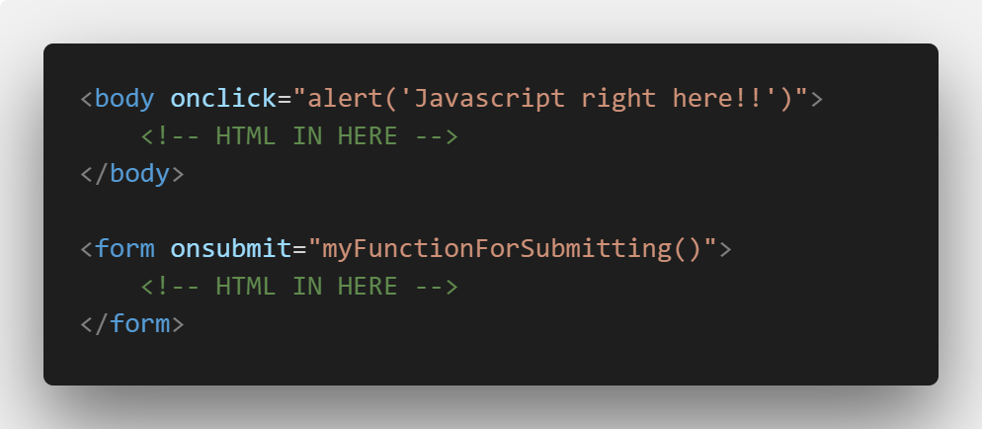
Events - HTML

Slide 57
Exercise - Create event handlers/listeners for onclick - Or any other event you like - Execute the event on lesson4.html and observe that your function is called. 15 minutes

Slide 58

AJAX Asynchronous JavaScript and XML

Slide 59
What is AJAX?
As mentioned is stands for Asynchronus JavaScript and XML
It is a technique aimed at making better and more interactive websites
Conventional websites transfer data synchronously between server and client
In essence AJAX allows us to update a webpage with new data, without reloading the page
AJAX is a misleading name, it is equally common to transport data using JSON, as compared to XML.

Slide 60
How it works
Browser
Internet
Create a request
Send requst
Server
Process request
Create response
Send response
Browser
Process response
Update page
Internet

Slide 61
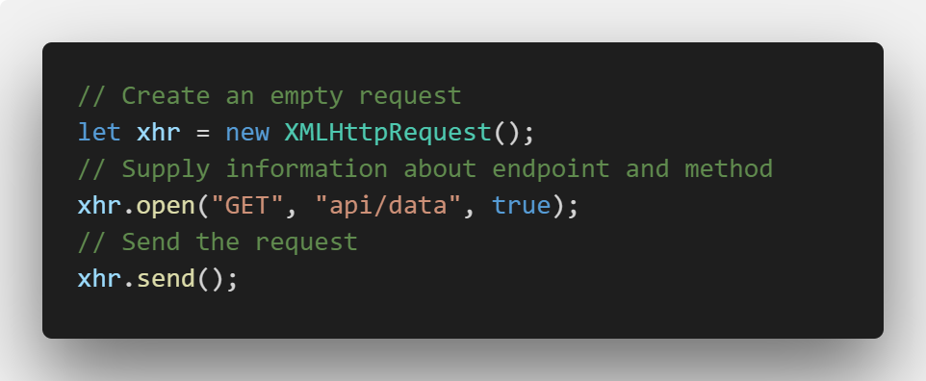
Working with AJAX

Slide 62
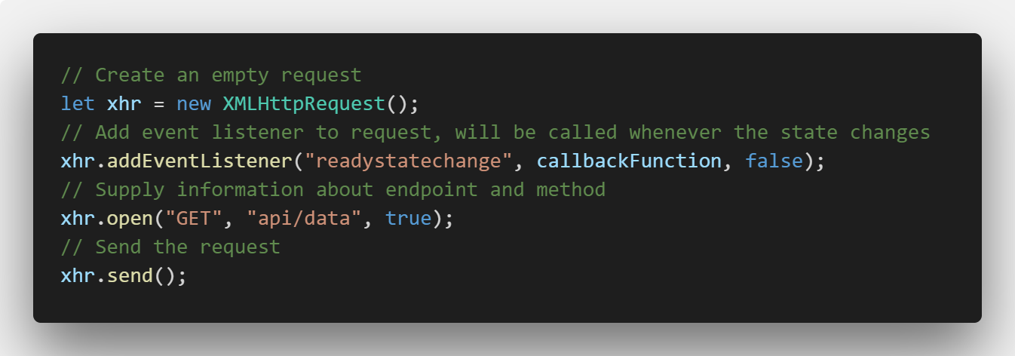
Adding an event listener
We have seen something like this before!

Slide 63
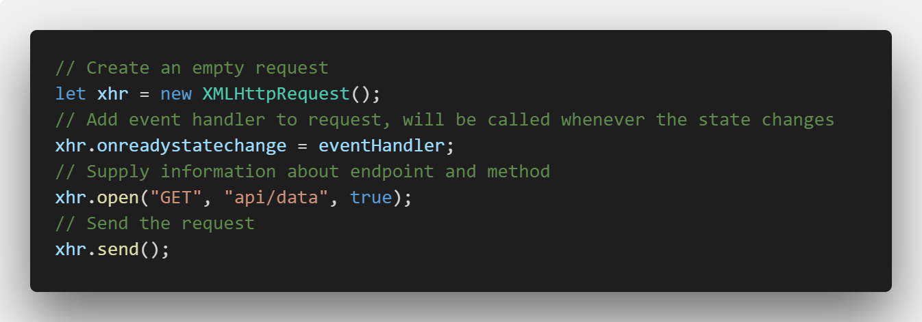
… and event handlers

Slide 64
Short side-track – HTTP Verbs
HTTP Verb | CRUD | Entire Collection (e.g. /endpoint) | Specific Item (e.g. /endpoint/{id})
POST | Create | 201 (Created), 'Location' header with link to /customers/{id} containing new ID. | 404 (Not Found), 409 (Conflict) if resource already exists..
GET | Read | 200 (OK), list of customers. Use pagination, sorting and filtering to navigate big lists. | 200 (OK), single customer. 404 (Not Found), if ID not found or invalid.
PUT | Update /Replace | 405 (Method Not Allowed), unless you want to update/replace every resource in the entire collection. | 200 (OK) or 204 (No Content). 404 (Not Found), if ID not found or invalid.
PATCH | Update /Modify | 405 (Method Not Allowed), unless you want to modify the collection itself. | 200 (OK) or 204 (No Content). 404 (Not Found), if ID not found or invalid.
DELETE | Delete | 405 (Method Not Allowed), unless you want to delete the whole collection—not often desirable. | 200 (OK). 404 (Not Found), if ID not found or invalid.

Slide 65
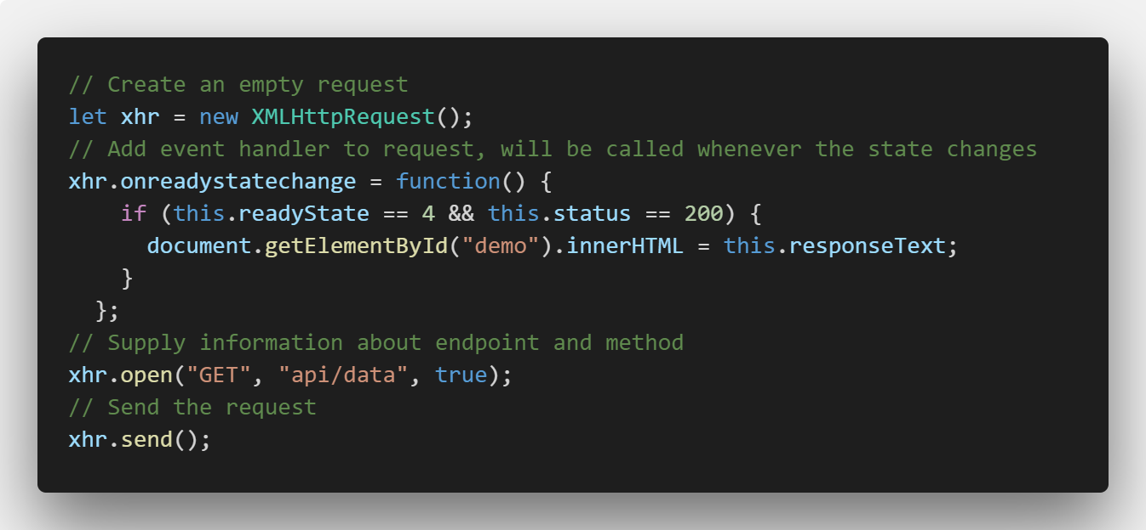
Retrieving data

Slide 66
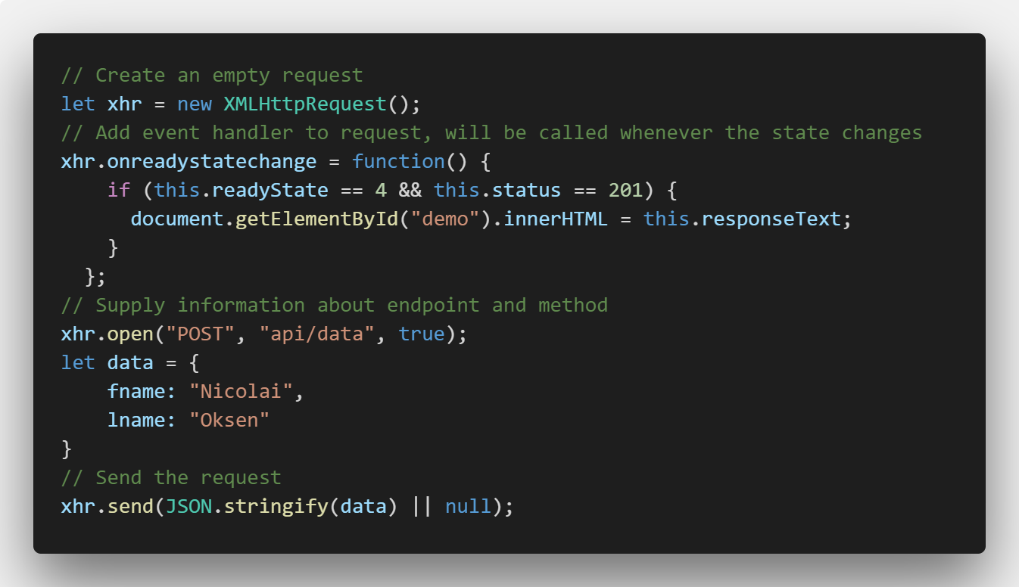
Sending data

Slide 67

JavaScript Object Notation

Slide 68
What is JSON?
Stands for JavaScript Object Notation
Is pronounced as Jason
Invented to enable easy transfer between server and client
XML serves the same purpose, but is not as lightweight
JSON is "self-describing" and easy to understand

Slide 69
Why use JSON?
JSON format is text only. Therefore it is easy to send to and from server
Since it is text only, it easy to use for any programming language
JavaScript natively support converting JSON to JavaScript objects

Slide 70
Syntax rules
Data is always in name/value pairs
Data is separated by commas
Curly braces holds objects
Square brackets hold arrays

Slide 71
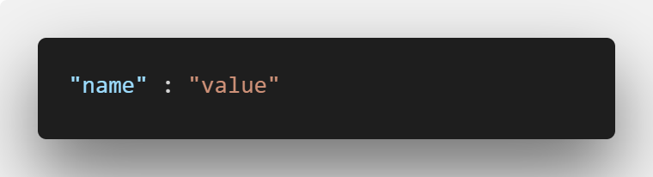
JSON Data

Slide 72
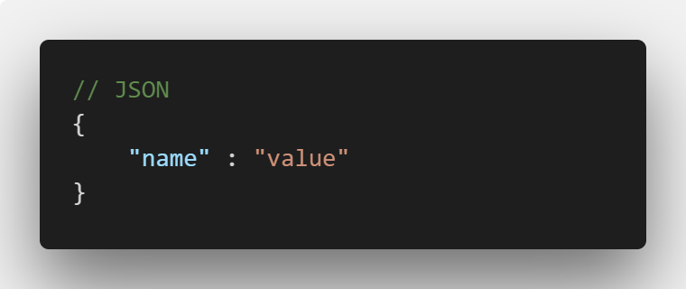
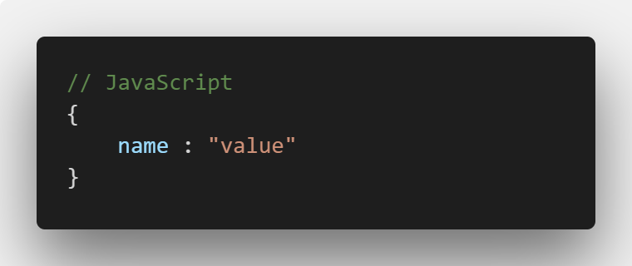
JSON Data - Objects

Slide 73
Data types in JSON
In JSON, values must be one of the following data types:
a string
a number
an object (JSON object)
an array
a boolean
Null
In JavaScript values can be all of the above, plus any valid JavaScript expression, including:
a function
a date
undefined
In JSON, string values must be written with double quotes:

Slide 74
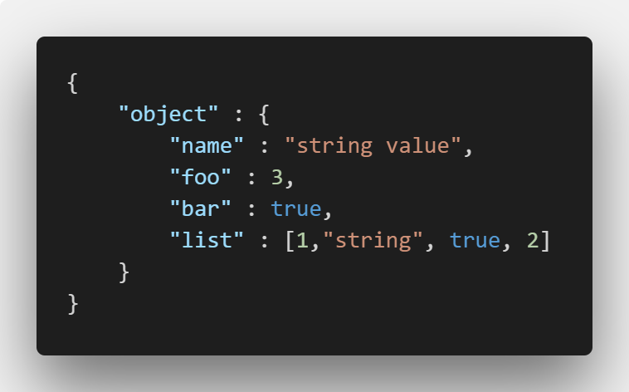
JSON Example

Slide 75
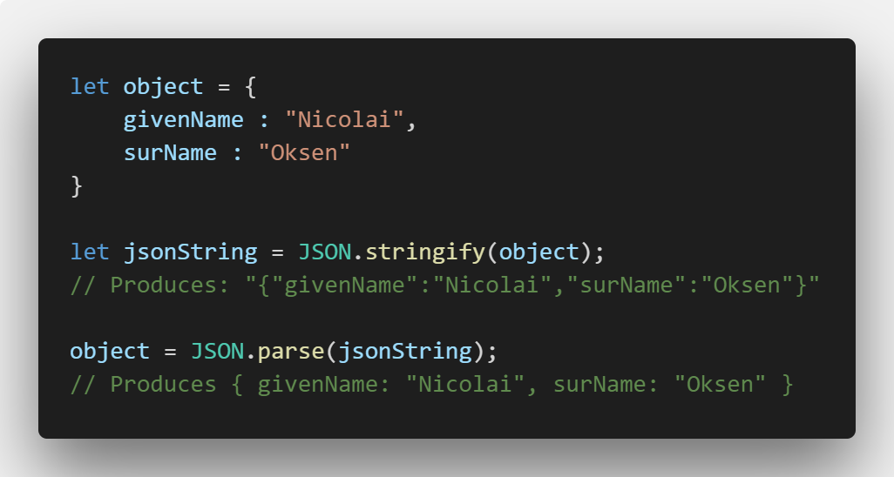
JSON to JavaScript… and back again!
Since JSON and JavaScript objects are based on the same syntax, it is easy to move between each format:

Slide 76
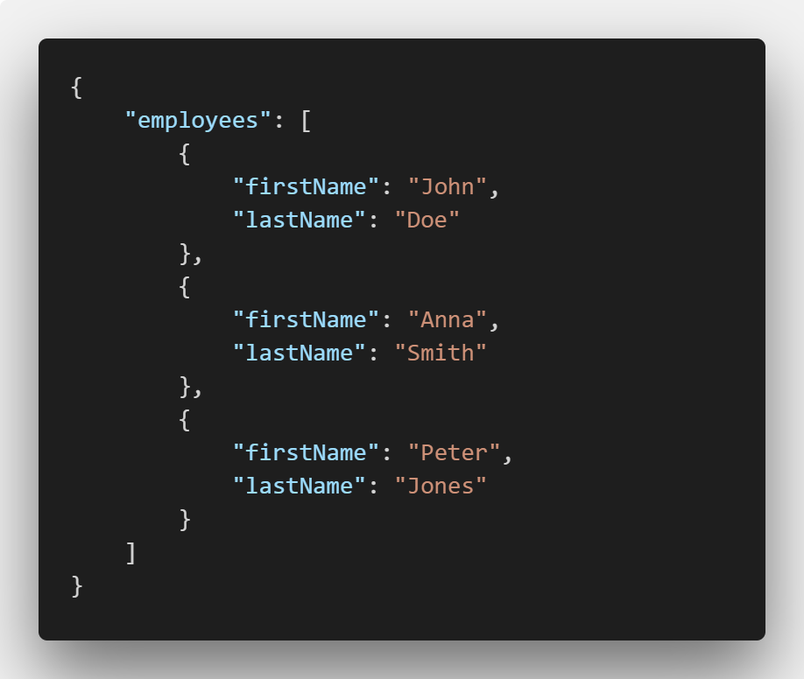
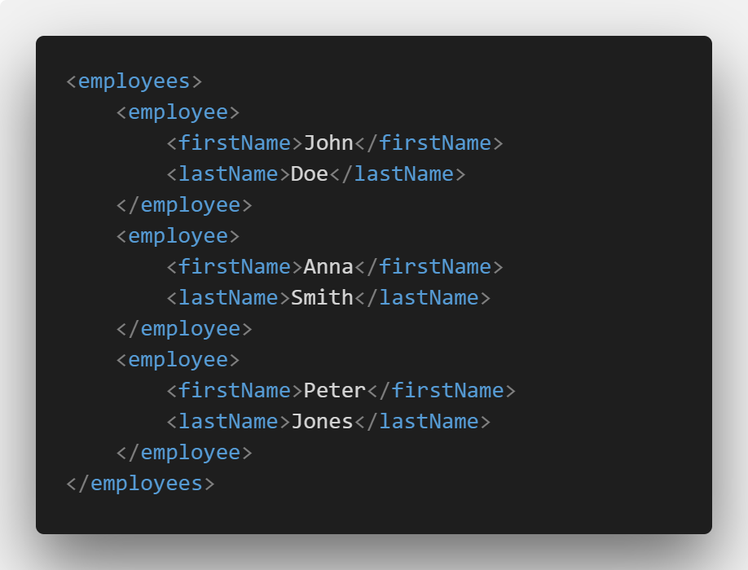
JSON vs. XML

Slide 77
JSON vs. XML (cont.)
JSON is Like XML Because
Both JSON and XML are "self describing" (human readable)
Both JSON and XML are hierarchical (values within values)
Both JSON and XML can be parsed and used by lots of programming languages
Both JSON and XML can be fetched with an XMLHttpRequest
JSON is Unlike XML Because:
JSON doesn't use end tag
JSON is shorter
JSON is quicker to read and write
JSON can use arrays

Slide 78
JSON vs. XML (cont.)
Is JSON better than XML?
That is up to you!
Benefits of JSON
Easy to parse to a JavaScript object
With XML, you have to access it via a DOM and convert
elements and values to a JavaScript object
I personally prefer JSON, but the syntax rules and ceremony around XML makes it a better choice sometimes.

Slide 79
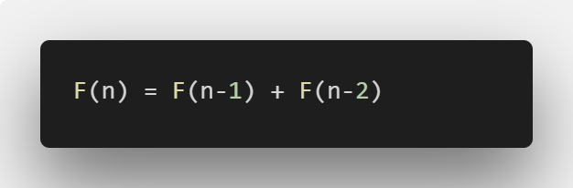
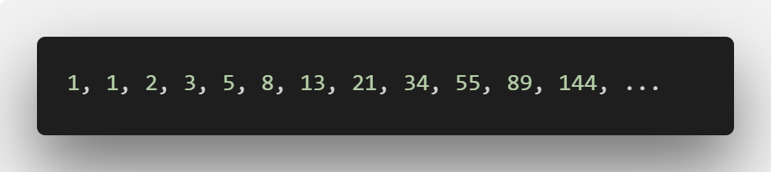
Exercise
Create a function to calculate find Fibonacci numbers.
You should be able to enter the amount of Fibonacci numbers you wish
Allow entering a number on a HTML page and execute function with a button
Add requested Fibonacci numbers to HTML page

Slide 80


Slide 81
Steps
Create an account on codecademy.com (You should have done that)
Start the course ”Learn JavaScript”
This course should teach everyone without any prior knowledge, the fundementals of JavaScript

Slide 82
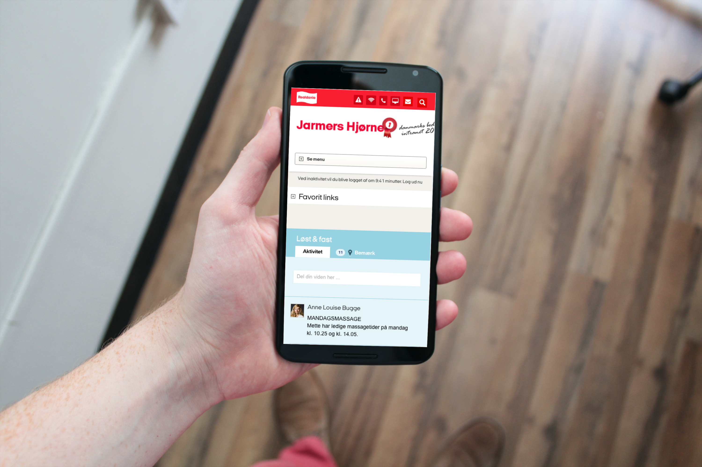
Questions?

Slide 83

Brugbare elementer
Dobbeltklik for at ændre farve eller indsætte baggrundsbillede

